Slide 1

Course Code: MATH 211
Course Title: MATH III
Lecture 3-6 (Complex Differentiation and Analytic Function)
Tazin Tamanna
Lecturer in Mathematics
Department of Science and Humanities
M.Sc. in Applied Mathematics (KU)
B.Sc. in Mathematics (KU)

Slide 2
Complex Differentiation
TYPE-I: FINDING DERIVATIVES
01
02
TYPE-II: Analyticity Test
03
Contents
TYPE-III: Harmonic Function
TYPE-IV: Find a function v for Analytic Function/Harmonic Conjugate
04

Slide 3
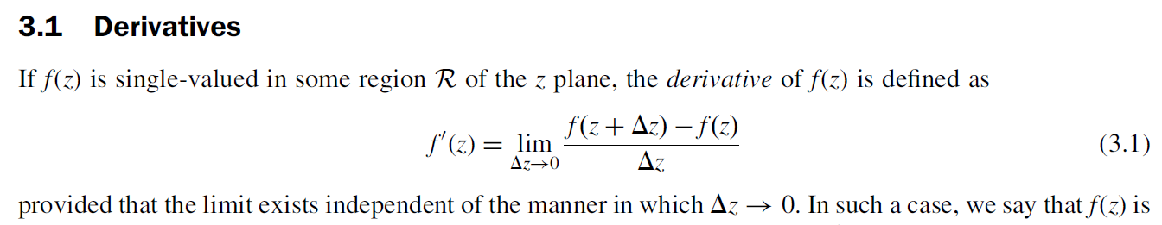

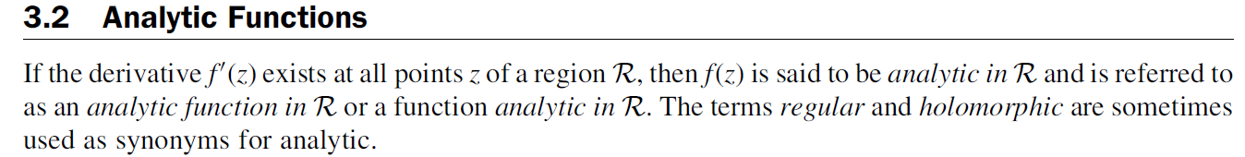
DERIVATIVES
Analytic Functions

Slide 4
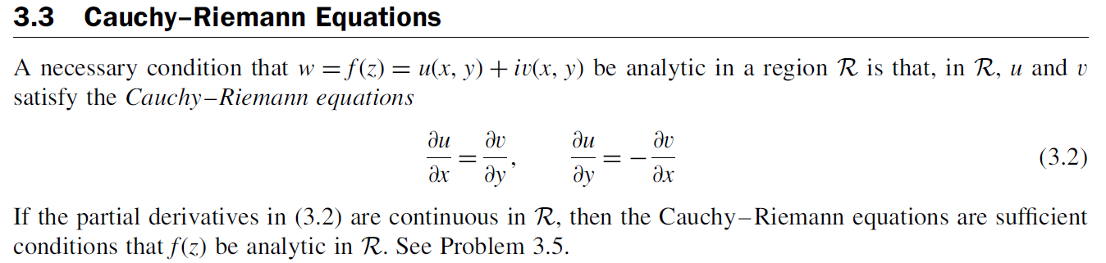
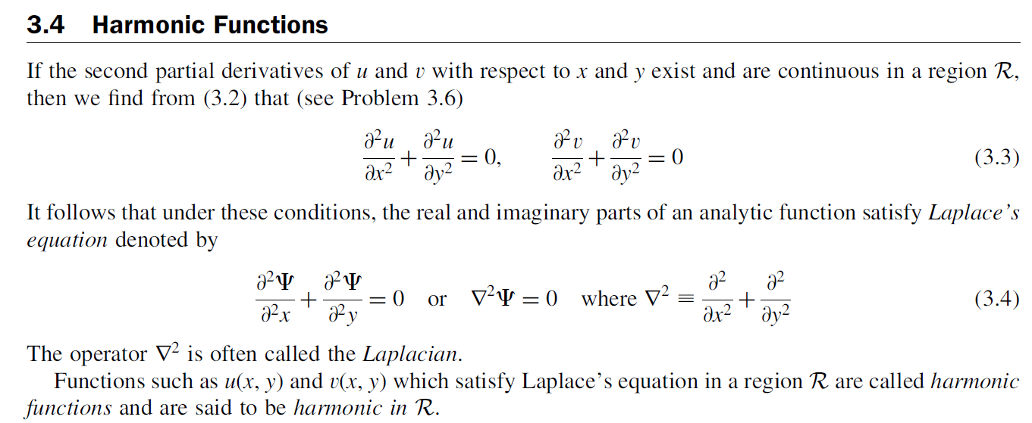
Cauchy-Reimann Equations
(1)
(1)
Harmonic Function

Slide 5
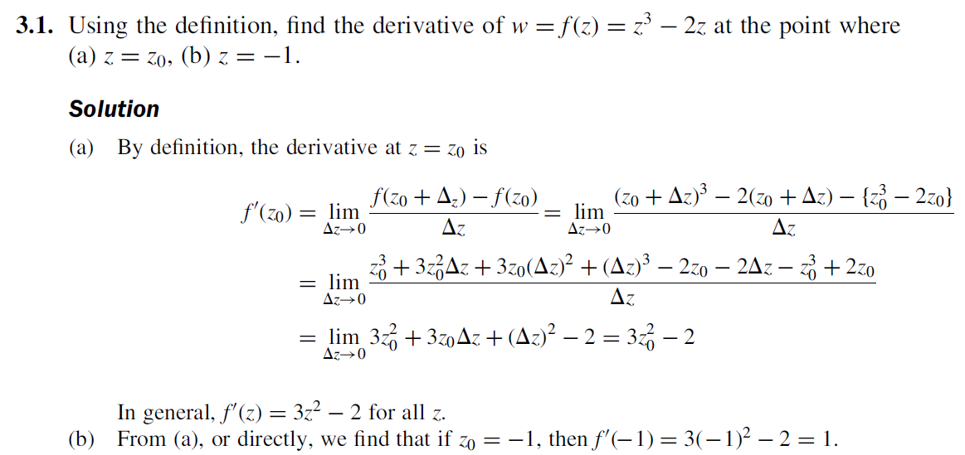
TYPE-I: FINDING DERIVATIVES
EX-1:

Slide 6
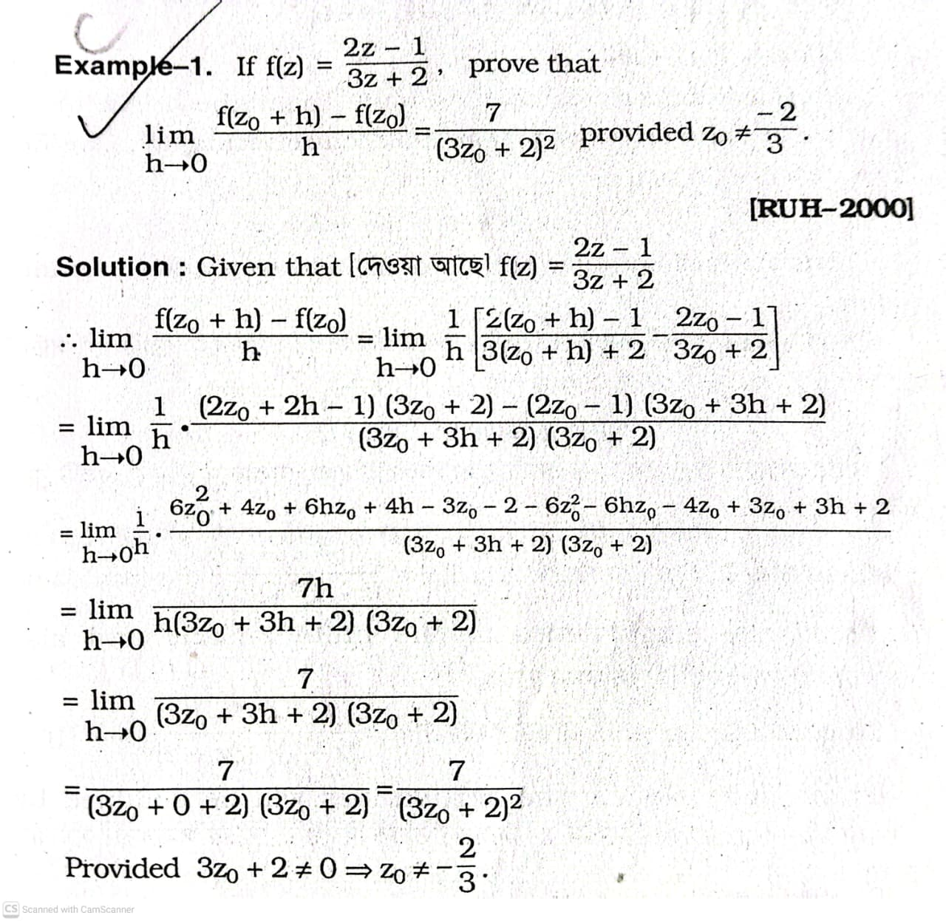
DO YOURSELF
2:

Slide 7
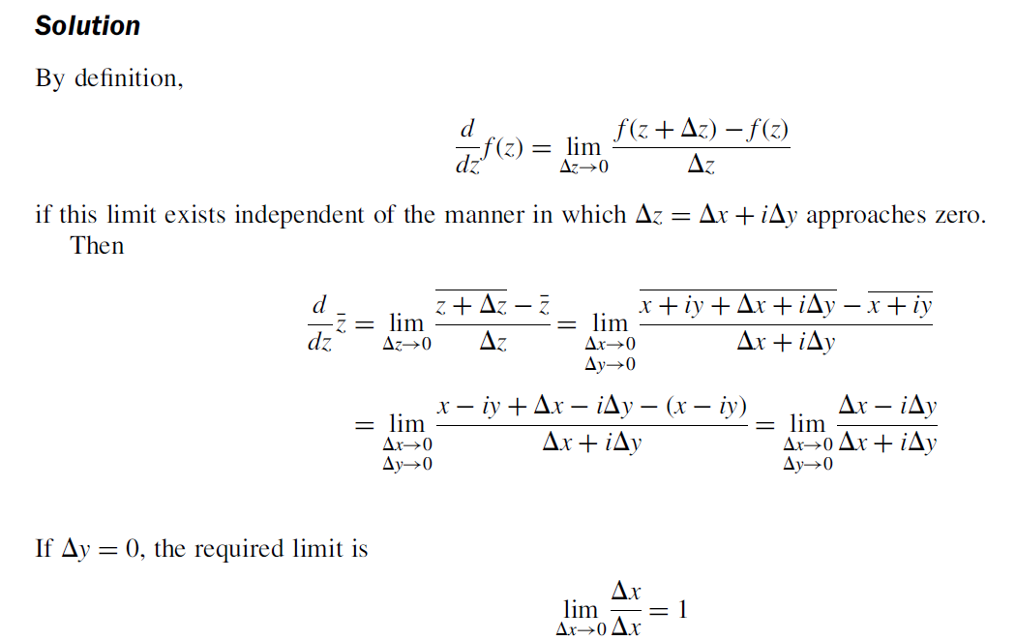
Example 3:

Slide 8
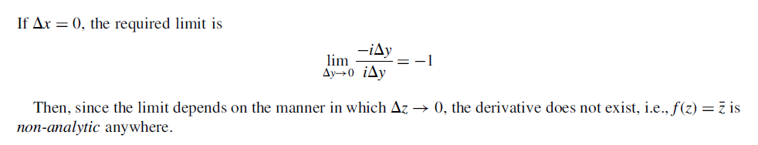

Slide 9
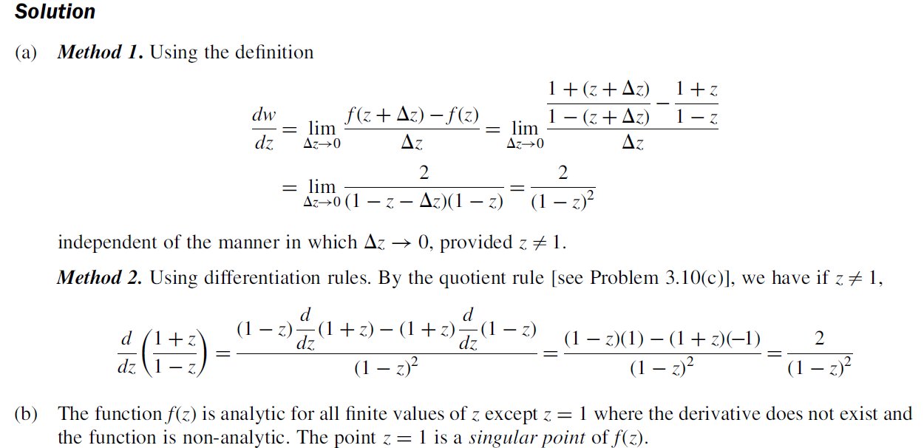
Example 4:

Slide 10
TYPE-II: Analyticity Test
EX-1:

Slide 11
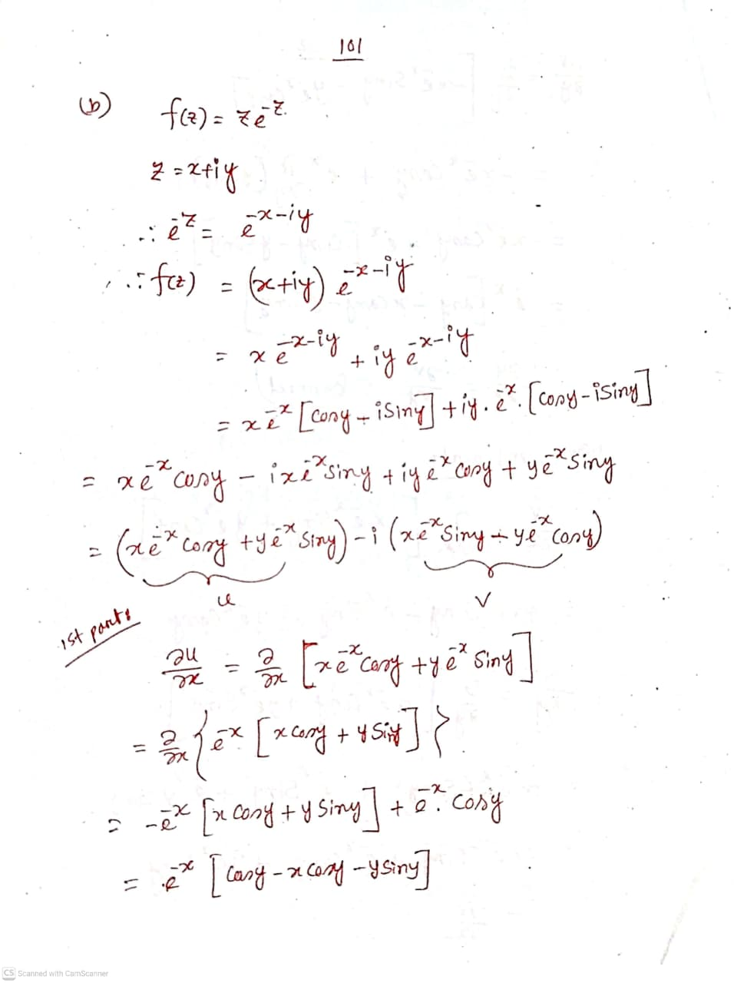
Example 2:
Solution:

Slide 12
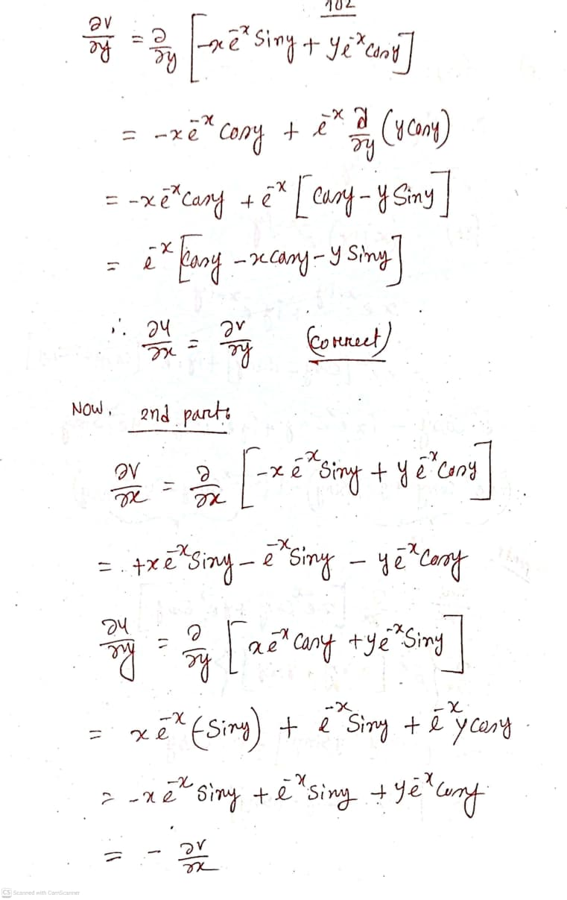

Slide 13
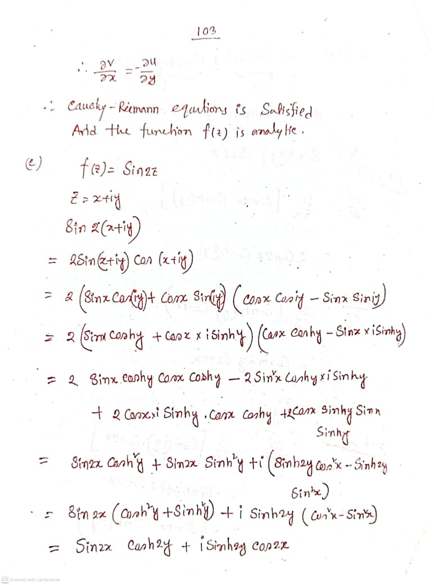

Slide 14
Example 3:

Slide 16
DO YOURSELF
Ex- 4:
Solution:

Slide 17
Ex- 5:

Slide 19
TYPE-III: Harmonic Function
Example 1:
Solution:

Slide 20
Example 2:
Solution:

Slide 21
DO YOURSELF
Example 3:

Slide 22
Example 4:
Solution:

Slide 23
TYPE-IV: Find a function v for Analytic Function/Harmonic Conjugate
Example 1:
Solution:

Slide 25
Example 2:
Solution:

Slide 27
DO YOURSELF
Example 3:
Solution:

Slide 29
Example 4:
Solution:

Slide 31
Example 5:
Solution:

